Slide 1

Software Group Project-1
Mentor : Prof. PRATHI SHAH

Slide 2


E-Commerce Website

Slide 3

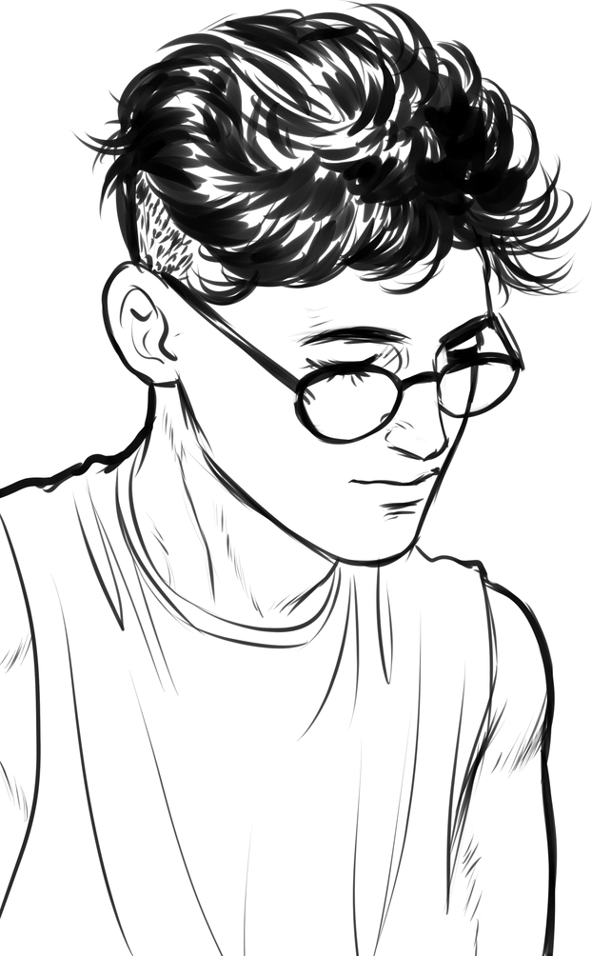
SGP-1
Meet the Group
BHARGAV SANDIS
21IT137
NISHIT ROKAD
(21IT136)

Slide 4
Introduction
SGP-1
The project is about developing a website for the clothes shop.
The website will showcase all types of fashions wear, for mens , womens ,kids.
The website will be having all the information of the Store along with other features .

Slide 5

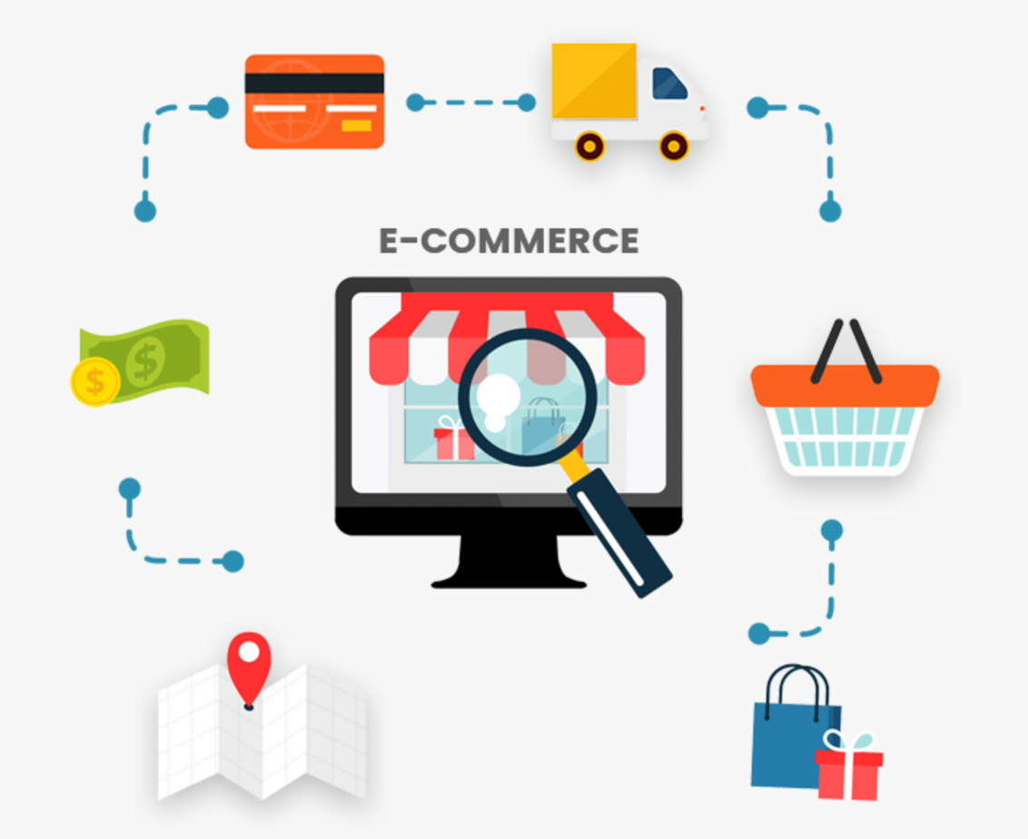
SGP-1
Objectives
The website is designed to give a brief idea about the Shop.
The website will contain all the necessary information about the products and the various brands dealing with.
Website is designed to give glimpse of the firm just by surfing so to get a rough knowledge without physically going to the Shop.
Due to pandemic all around the world, people are becoming more careful so website will help just by surfing it.

Slide 6
SGP-1
Problems
Website is a best visual representation of the firm that can be opted to showcase the brands and other features.
Through our website we can pictorically showcase the products to the customers from the comfort of their home.
Website will be having all the customer care number of the brands so customers can directly visit website and register their complaint regarding the product.
Through website, customers can also request for a price and other.. of the certain products and get a reply from the shop without visiting.

Slide 7

SGP-1
Project Scope
The basic motto of this project is to give customers a brief idea about the brands and the products the shop is dealing with.
The purpose of this website is to give the customers the glimpse of our shop and variety of the fashion Wear.
Our website provides all the necessary details needed by the customer and help them selecting the right products from the comfort of their homes

Slide 8

Motivation
The website is designed in a way to cater the required information to the customers without visiting the shop physically.
The flow and structure of the website is sourced from the owner of the firm and from the official websites of the brands they are dealing with.
As due to increase in the number of technology users day by day and due to the pandemic, website will be the best service a firm can give to gain the customer's interest and interact with them virtually.
One of the main reasons to have a website for the business is to increase the organization's credibility.
SGP-1

Slide 9

SGP-1
Technology used
Frontend : HTML,CSS,JS
Editor : VS Code

Slide 10

SGP-1
Hardware requirement
CPU: for web 1.6 GHz , for web and database 4 x 1.6 GHz CPU.
RAM: 2GB.
Minimum database space: 1GB.
CPU: Quad 2GHz+ CPU.

Slide 11

SGP-1
Software requirement
Operating System : Windows,Mac,Linux
Web Browser : Chrome,Safari,FireFox
Web Server : Netifly,XAMPP
Database : MySQL 5.1 and above

Slide 12
Now lets see the implementation!!

Slide 13






Flow of implementation
SGP-1
Draw a rough sketch of the homepage...
Start implementing for the homepage
Design for other Webpages
Link other Webpage with the homepage
Give Final edits

Slide 14

SGP-1
Flow of the project
Types
Products
Watches
Footwear
perfume &
Goggles
Clothes
Mens
Womens
Kids

Slide 15
SGP-1
Future Implementation
Admin Panel Dashboard
Shopping Cart
Discount coupon
Ratings

Slide 16
References
01
www.w3school.com
02
www.youtube.com
03
Reference has also been taken from web designing and development tutorials.

Slide 17
Thank
You!
Do you have any questions for us?

